Slide 1
Unit 3: Text-Based Programming
Lesson 1
From https://www.futurelearn.com

Slide 2
What is Programming?
Think back to our discussion about programming in Unit 2…
When you create a program for a computer, you give it a set of instructions, which it will run one at a time in order, precisely as given. If you told a computer to jump off a cliff, it would! 1. turn and face the cliff 2. walk towards the cliff 3. stop at the edge of the cliff 4. jump off the cliff

Slide 3
To stop computers constantly falling off cliffs, they can also make choices about what to do next: If I won’t survive the fall, don't jump off the cliff Computers never get bored and are really good at doing the same thing over and over again. Instruction 2 above might look in more detail like this: 2a. left foot forward 2b. right foot forward 2c. go back to 2a

Slide 4
These three concepts are the basic logical structures in computer programming: Sequence: running instructions in order Selection: making choices Repetition: doing the same thing more than once
Add to these concepts the ability to deal with inputs and outputs and to store data, and you have the tools to solve the majority of all computing problems.

Slide 5
Using an IDE
To create Python programs you need a text editor to write your code and a Python interpreter which takes your code and runs it. An editor, interpreter and other useful tools (such as a file browser) are often bundled together into an Integrated Development Environment (IDE), which makes the process of creating programs much easier. You will be using an IDE to create, run and test your Python programs. You can install an IDE on your computer, or you can use an internet browser to access an online IDE. An installed IDE has the benefit of being able to work when you are not connected to the internet. On the other hand, an online editor doesn’t require anything to be installed.

Slide 6
Writing Your First Program
The start of every new programming experience is creating a “Hello World” program. It’s one of the simplest programs you can create, and it will put the message “hello world” on the screen. Programmers will often create a “Hello World” program to test that everything is working before they start anything new, and this is what you are going to do.

Slide 7
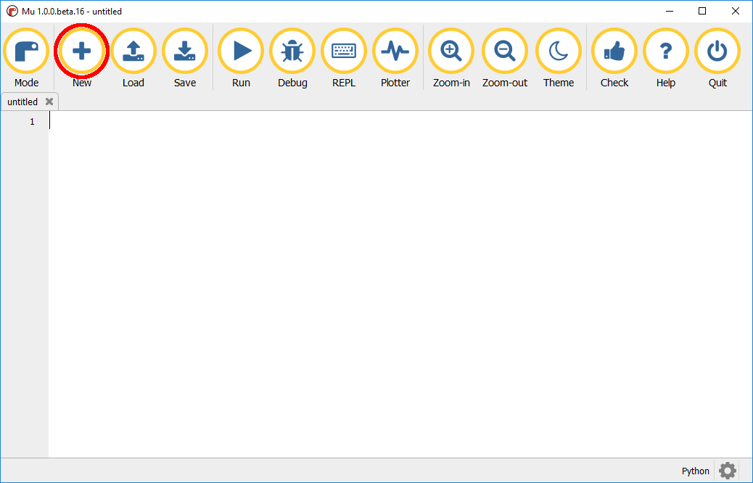
Create a new program in Mu or idle by clicking the New icon in Mu or open a new file in Idle.

Slide 8
2. Type the following code into the editor: print("hello world")
3. Click Save to save the program.
4. Navigate to the Unit 3 Activities folder. 5. Enter the file name helloworld and click the Save button.

Slide 9
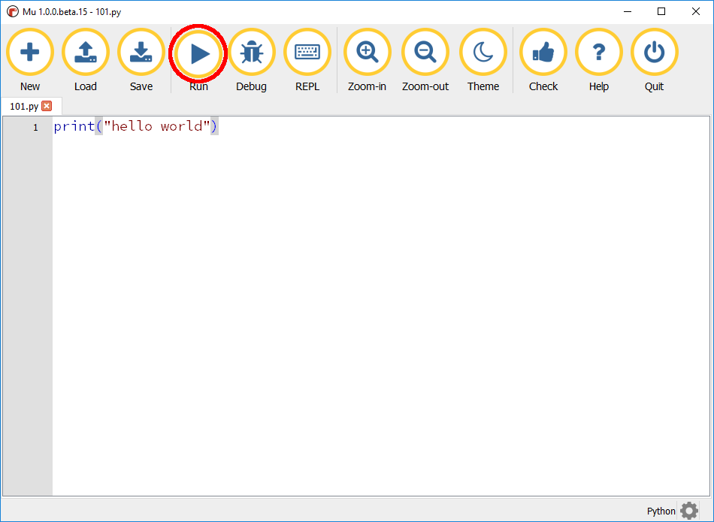
5. Click Run in Mu, or select Run then Run File in Idle to test the program. f5 on your keyboard is the shortcut to run a file.

Slide 10
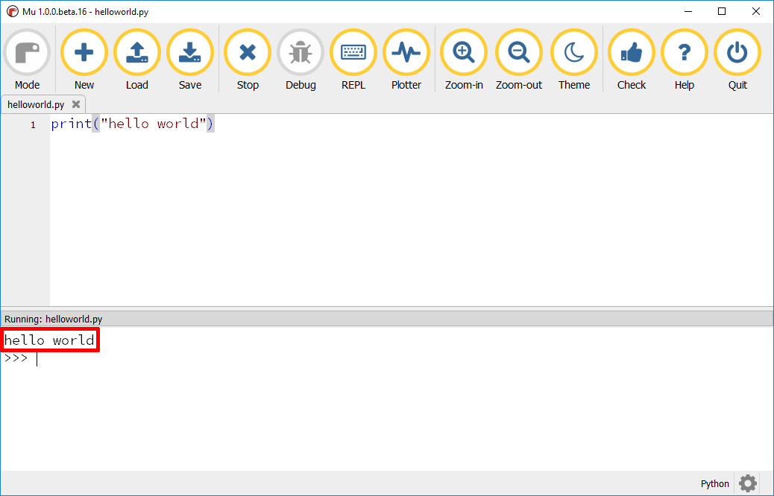
The message “hello world” should appear in the REPL.

Slide 11
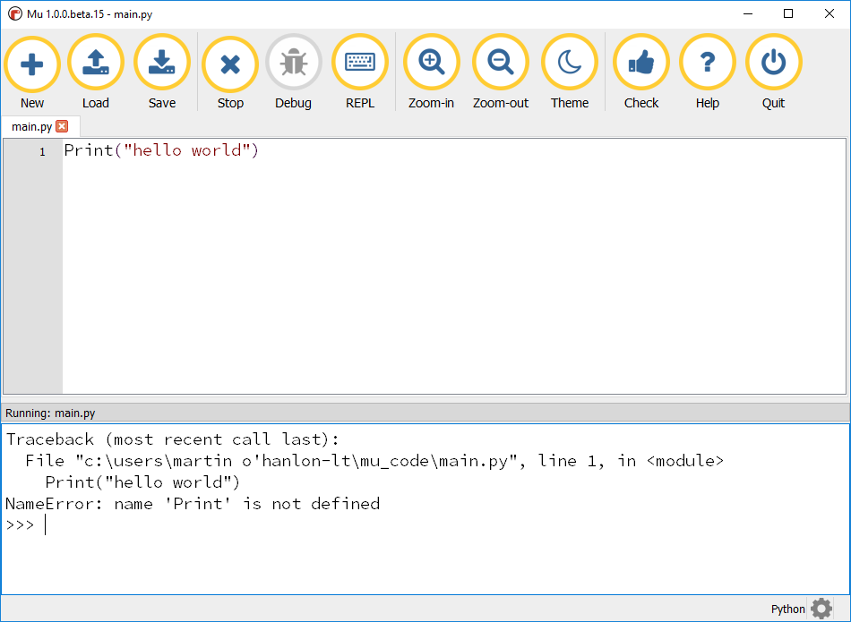
Program Errors
Any errors in your program will appear in the REPL with a description.

Slide 12
Debugging
If you get an error, look over the code carefully to make sure everything is correct. There are a few important points to make which might help if you experience an error:
The code is case-sensitive, so capital letters are important - print is not the same as Print
Text, such as a message to be printed, needs to be between speech marks so be sure to put the "hello world" message in between " "
print expects the message to be in between parentheses (brackets)
If you need to change your program, stop it and run it again by clicking Stop and then Run.

Slide 13
Congratulations!
Congratulations! You have completed your first text-based program!

